Slide 1
Child Wellbeing and Protection in Sport (CWPS) Tool

Slide 2
What is the CWPS Tool?
The CWPS Tool has been developed by sportscotland and Children 1st to help sports organisations create safer environments for children and young people in sport. Based on the Standards for Child Wellbeing and Protection in Sport, the tool allows the user to self-assess against the Standards, then create an action plan to put in place measures to better safeguard children and young people. By answering the self-assessment questions and accessing the associated information and resources, the tool has an educational function too.
Notes:
This slide is an option depending on your audience to explain the purpose of the tool.

Slide 3
The Standards for Child Wellbeing and Protection in Sport
Why an Online Tool?
Tool Aim
To develop an on-line self-assessment tool for clubs to support SGBs with the implementation of the Standards for Child Wellbeing and Protection in Sport in clubs.
SGB response to Aileen Campbell, MSP on the support SGB needed to improve standards within clubs. (2016) Online tool was overwhelmingly requested.
Recommendation within the Child Wellbeing and Protection in Sport Report (2017) to develop an online tool.
Notes:
How has the Child Wellbeing and Protection in Sport Tool come about?
SGB response to Aileen Campbell, MSP on the support SGB needed to improve standards within clubs. (2016). Online tool was overwhelmingly requested.
Following the horrendous revelation of historic cases of child abuse in sport and other child protection cases in and around 2016. MSP Aileen Campbell asked SGB what do they need to improve safeguarding standards within their sport. Along with more education and training, the development of an online self assessment tool was unanimously deemed essential.
recommendation within the Child Wellbeing and Protection in Sport Report (2017) to develop an online tool.
The Standards were launched in December 2017 following the publication of Children 1st report into the Standards for Child Wellbeing and Protection in Sport. The development of an online tool was one of the recommendations. The focus from this point in time has been the implementation of the Standards into SGB policy and practice. To embed this compliance with the Standards is a standard condition of investment from sportscotland that all invested SGB are compliant in the Standards. Children 1st work with SGB to support them in achieving the Standards and embedding good practice.
Aim of the Tool: To develop an on-line self-assessment tool for clubs to support SGBs with the implementation of the Standards for Child Wellbeing and Protection in Sport in clubs. -

Slide 4
8 Sections based on the Standards for Child Wellbeing and Protection in Sport
Every child’s voice is taken into account and their rights are respected
Every child’s wellbeing is promoted, supported and safeguarded
Every child is protected from abuse
Every child is respected without discrimination
Every child has volunteers and staff working alongside them who have been considered suitable to work with children and young people
Notes:
Opportunity to explain the 8 standards that the self assessment covers. Explains the different sections within the tool and the areas covered.

Slide 5
8 Sections based on the Standards for Child Wellbeing and Protection in Sport
Every child’s sports coach and volunteer is well supported and trained
Every child’s sports organisation is managed well and accountable for keeping children and young people safe
Every child’s sports organisation evaluates how it safeguards children and young people and makes improvements where necessary
Notes:
Opportunity to explain the 8 standards that the self assessment covers.

Slide 6
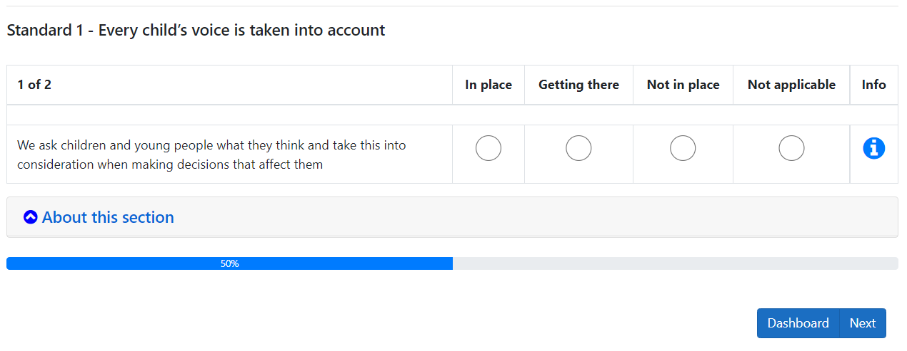
Notes:
Example of the question alongside the standard as seen in the online tool

Slide 7
Demonstration
Notes:
If you are planning to give a live presentation of the tool this slide can introduce this section

Slide 8
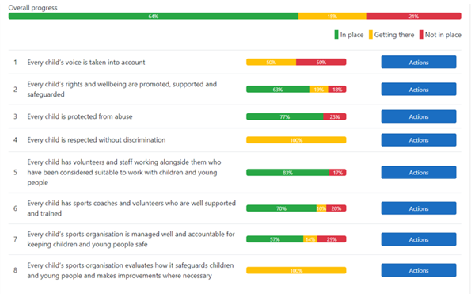
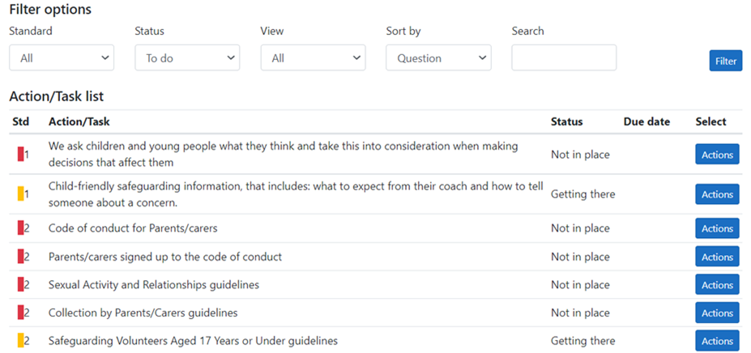
Notes:
Example screen shots to show the tool with data already uploaded. Opportunity to note the progress bar and the ability to create tasks/actions

Slide 9
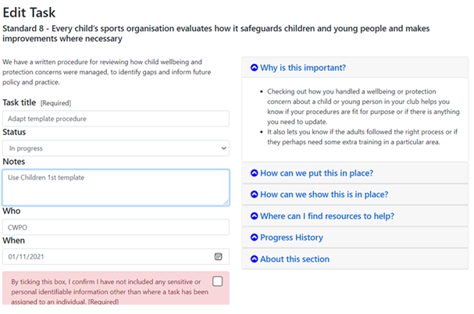
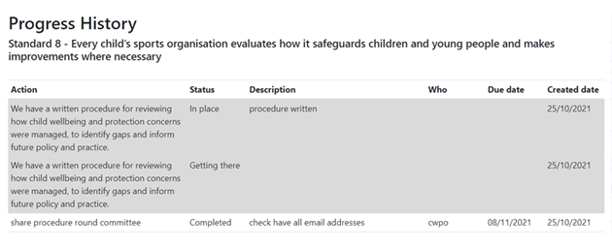

Slide 10
Tips For Success
Ensure clubs have an understanding of procedure for enquiries
Make sure clubs are aware of the current resources that will help them complete the tool

Slide 11
Key Benefits
Education and awareness
Self assessment
Helps with planning at club level
Highlights areas of action
Planning for the future
Helps to create safer environments
Creates Data to strengthen good practice
Notes:
Ability for all clubs to access the tool which directly links to resources, help and encourages action
Allows an instant assessment of where clubs are and what areas need focus
Emphasise the ability of the self assessment process for clubs. Benefit of completing the tool in their own time in their own environment. Allows a visual to what can be an admin heavy process and task.
Secure location to store safeguarding information.

Slide 12
Q & A

