Slide 1
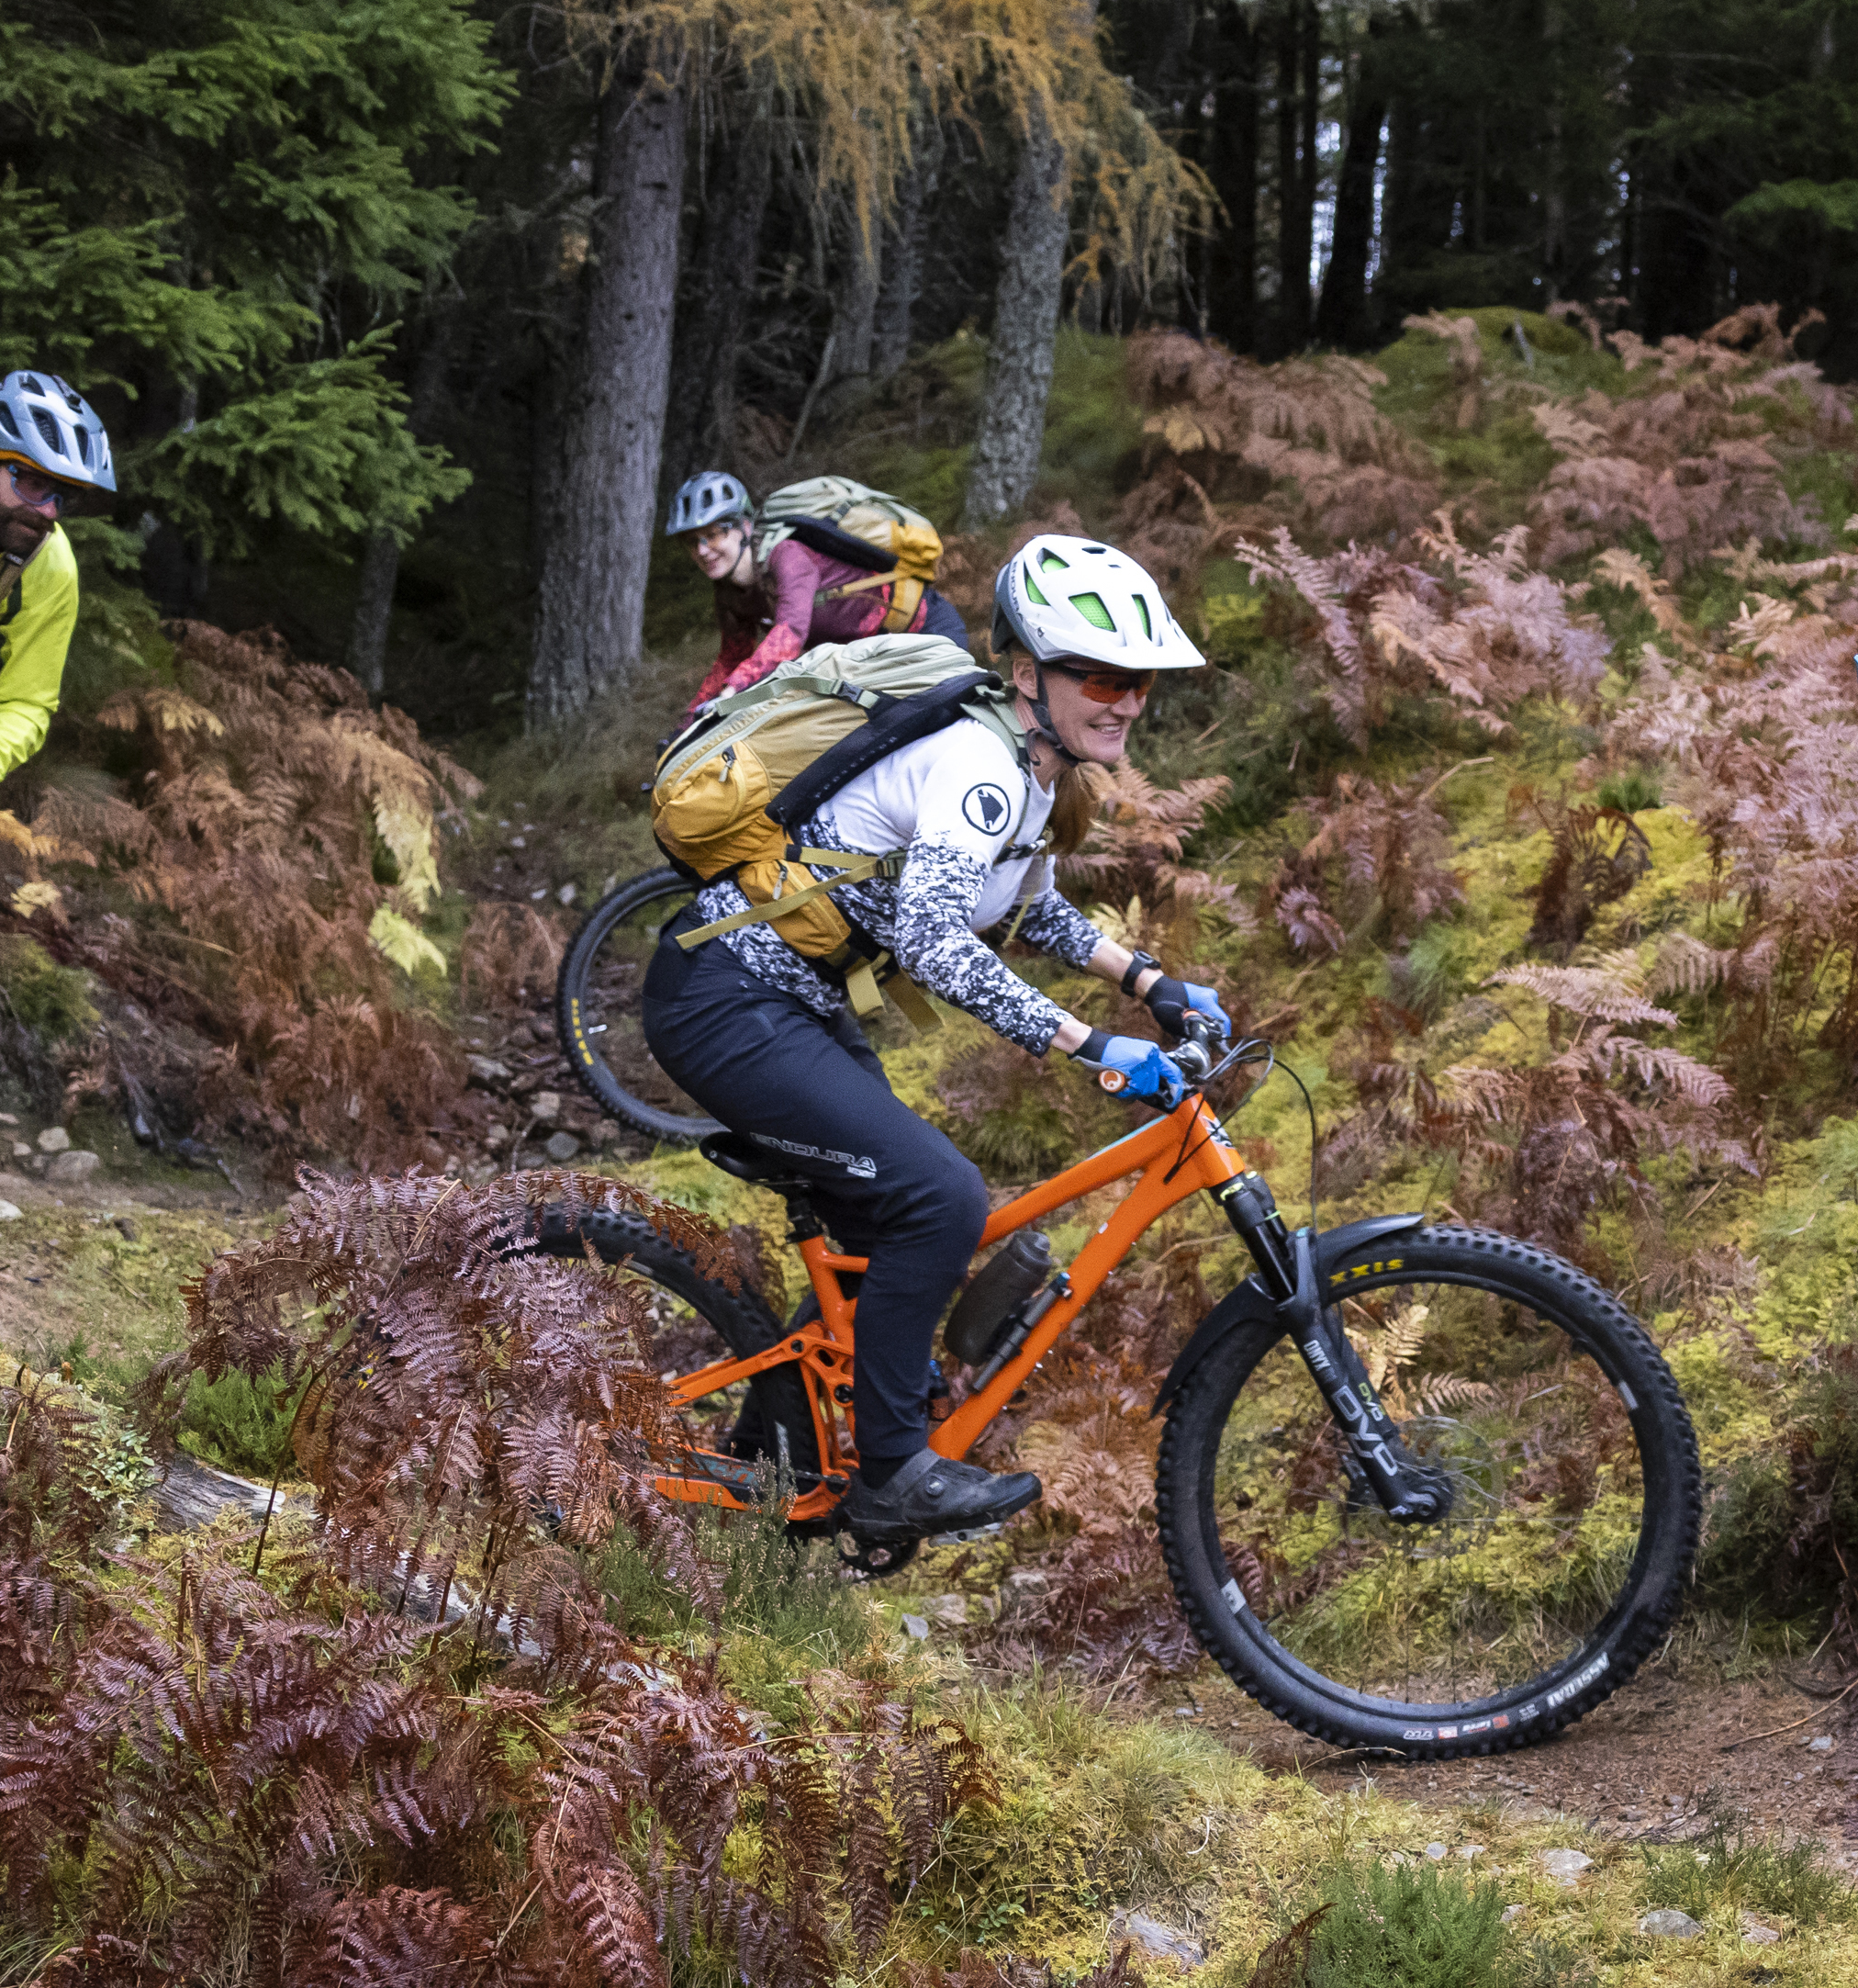
Summer of Sport
Notes:
Welcome and introduction
Exciting opportunity to
Pulled together a draft using evaluation from 2021
Everyone to contribute use the hand function or pop comments and thoughts in the chat

Slide 2
Summer of Sport £13.75m
Core work strands | Focus | Budget Allocation
Local partner allocation | Opportunities for children and young people age 3 to 26 years, to help them get active, stay active and improve their lives | £12m
National partner and SGB fund | National investment to compliment, add value and support local plans for the delivery of summer of sport | £1.75m
Notes:
Talk through the £20million verbally and focus on the £13.75m split
One off one year investment that needs to be spent by March 2027 (Summer of sport and beyond)….
£20m was announced
OF the £15m there is another
£1.25k in discussion for CWG activation and profile of summer of sport
£5m staying with SG There is another £5m that SG are distributing:
£2m swimming only element that’s not one off one year spend
£2m SFA - 100 clubs
£1m physical activity partners

Slide 3
Summer of Sport
Core work strands | Focus | Budget Allocation
Summer of Sport local partner allocation | Opportunities for children and young people age 3 to 26 years, to help them get active, stay active and improve their lives | £12m
Formula: £12m allocated to 32 x LAs proposed based on:
50% on population of children and young people (population)
45% on population of children and young people living in low-income families (deprivation)
5% on rurality (rural)
Notes:
In draft until we receive final confirmation from Scottish Government which we are hoping to be finalised and communicated by end of next week

Slide 4
What the funding is for
Opportunities
Deliver a range
Pathways
Provide clear
Enhancement
Build on
Targeted
Workforce
Introduce
Recruit, train
Profile
Contribute to
of safe,
welcoming
inclusive
pathways from
short term
activity into
sustained
participation in
school, club
community
opportunities
that reduce
barriers to
participation
provision,
particularly
during the
summer period
and beyond,
avoiding
duplication and
strengthening
what already
works
existing
targeted
initiatives
where gaps
exist, with a
focus on long
term
engagement
beyond the
funding period
and retain
coaches,
volunteers and
leaders to grow
local
capacity
raising the
profile of sport
and
workforce
and
sport
Positive, fun, inclusive, inspiring experiences for children and young people
FREE/TARGETED OR AT A REDUCED COST
Notes:
As guidance for partners
The money has originated from Government's Child Poverty action plan with that being a key driver for what the investment is aligned too.
Free / targeted or at a reduced cost we do not want to displace activity bearing in mind that it is only one off investment so if your LA or LT use summer to income generate we want to allow you locally to make the call on what you charge for and who you charge.
Workforce key can you accelerate training delivery to some of your current workforce can you further enhance relations with college and uni sector to train new deliverers and coaches that you can perhaps also utilise going into the new term. This is an opportunity to use the investment to upskill your workforce

Slide 5
The Approach
Effective partnerships e.g. local, national, third sector, tertiary education.
Co-creation of approach
Integration of wider services/non- traditional groups
Build on trusted relationships
Strengthen delivery of priorities and outcomes locally
Build on existing services, assets and knowledge of what works
Partnerships with SGB’s and clubs to help clubs support transition
Notes:
Local relations
Partnerships are fundamental
Local council and trusts delivery and the reach organisations play – working together

Slide 6
Target groups
Minority ethnic communities
Families with a disabled child or adult
Young Carers
Care experienced young people
Families with a mother aged 25 and under
Families with a child under one
Families with three or more children
Universal offer to all children and young people, aged 3-26 years primarily, while specifically targeting those that are at a higher risk of poverty, including from the following family types:
Rurality: Consideration should be given to how activities are delivered in remote/rural areas. Accessible transport requirements should be considered.
Notes:
First 6 target groups are from the child poverty action plan
Final one we have added as a key target
We are not saying you have to hit all of these groups with what you plan to deliver however they are worth bearing in mind when you plan who your activities are accessible too and I have no doubt that a lot of the families you currently work with will be across these groups

Slide 7
SGB and National Funding Process
A panel will assess submissions and agree funding awards.
National partners and SGB’s will apply through an application process, outlining their case for investment and demonstrating how the proposed activity will improve outcomes aligned to the purpose of the investment.
Funding awards will be approved by a supplementary panel and paid to National partners / SGB directly through existing mechanisms.
Principles:
The application process will be developed in conjunction with other funding opportunities
Guidance for local and national partners will be consistent e.g. approach / target groups
Local partnerships will be required to maximise resource
Notes:
Hand over to Bob for an overview of nation partners and SGB fund

Slide 8

free holiday time activities which are active, fun and creates social connections
current holiday programmes at a subsidised rate
expansion of current holiday provision into communities
term time sessions leading to club and community opportunities
maximizing use of outdoor space
multi-sport camps, festivals and taster events with explicit transition into clubs
connecting schools and community provision such as buddy sessions, join-in weeks
residential opportunities for staff and deliverer training and residentials for participants over summer
supporting local clubs to enhance accessibility/transitions
Notes:
Not an exhaustive list will let you have a read through and there is a page 2

Slide 9
Examples of what can be funded
free holiday time activities which are active, fun and creates social connections
current holiday programmes at a subsidised rate
expansion of current holiday provision into communities
term time sessions leading to club and community opportunities
maximizing use of outdoor space
multi-sport camps, festivals and taster events with explicit transition into clubs
connecting schools and community provision such as buddy sessions, join-in weeks
residential opportunities for staff and deliverer training and residentials for participants over summer
supporting local clubs to enhance accessibility/transitions
Notes:
Not an exhaustive list will let you have a read through and there is a page 2

Slide 10

an inclusion uplift for activity targeting families at a higher risk of poverty
Travel and food costs for those on low incomes and / or in rural communities
family activation grants for partners to remove immediate barriers (e.g. transport, childcare, family taster sessions, kit)
purchase of equipment and facility hire
training and development for young leaders and volunteers
approaches to recruit / retain volunteers and young leaders
provision of additional training around inclusion, trauma-informed practise
workforce costs including coaches, sessional staff and volunteer expenses/supporting PVG
administration and / or coordination costs
targeted outreach and engagement activity
Notes:
5mins

Slide 11
Examples of what can be funded
an inclusion uplift for activity targeting families at a higher risk of poverty
Travel and food costs for those on low incomes and / or in rural communities
family activation grants for partners to remove immediate barriers (e.g. transport, childcare, family taster sessions, kit)
purchase of equipment and facility hire
training and development for young leaders and volunteers
approaches to recruit / retain volunteers and young leaders
provision of additional training around inclusion, trauma-informed practise
workforce costs including coaches, sessional staff and volunteer expenses/supporting PVG
administration and / or coordination costs
targeted outreach and engagement activity
Notes:
5mins

Slide 12
Celebrating success - examples
Nature and range of delivery partners engaged
01
Number and range of sessions delivered
02
Number of children and families engaged (including % from target groups)
03
Number of new coaches and volunteers engaged and supported in delivery
04
Utilise existing data collation methods
Notes:
M and E – we are currently working on the reporting that will sit alongside this and we are taking into consideration the feedback from previous that partners asked for site of this as early in the process as possible so they know the expectations.
Where possible we will utilise existing data collection methods and will be a mix of quantitative and qualitative measures along with case studies which we are considering partnering with an external contract.

Slide 13
Broader impact ambitions
Enhancement of the sporting system
More children and young people accessing local sport
More inclusive local provision
A more diverse and skilled workforce
Accelerated local plans
Engagement of a wider range of partners
Enhance culture of co-creation of local services for sport
More children and young people in poverty accessing local sport
National participation survey / externally commissioned evaluation
Notes:
Draft impact ambitions

Slide 14
Timelines and next steps
Communications to local partners on funding allocations - March
Communications to national partners on process and timelines (application based)
Planning / workforce phase April to June for delivery from June to March 2027
Delivery and monitoring May / June onwards
Externally commissioned evaluation TBC
Notes:
5 mins

Slide 15
National partners and SGB’s Timelines
Drop-in session 25th March
Rolling applications invited up until 1st May
Decisions on applications by 8th May
One-off payment through supplementary process
Notes:
5 mins

Slide 16



PLAYING
OUR PART

