Slide 1
Plan
Intro (15min)
EXERCISE 1 – Pairs: What do you design (5mins)
EXERCISE 2 – Groups of 4-5 : Images (15mins)
Break (5mins)
EXERCISE 3 – Groups of 3:design wallet (15mins) : reflection (15mins)
Discussion and next steps (20mins)

Slide 2
Welcome!
New approach to equality diversity and inclusion

Slide 3
Today
Our new approach to Equality, Diversity and Inclusion
How did we get here?
Be an inclusive designer

Slide 4
Working together
This is a learning space:
Talk in whatever words you currently know.
It doesn’t matter if you use awkward or dated language. The important thing is that you start to explore openly what’s on your mind as regards the topic.
Listen to understand, not to respond
Monitor your airtime, let people finish their thoughts.
It’s ok to step off the call or turn the camera off
Maintain confidentiality

Slide 5
Sport for Life
Notes:
We launched Sport for Life in 2019
We have added three strands to help us put the commitment to inclusion into practice.

Slide 6
Inclusive by design
Inclusion shouldn’t be an afterthought, or a bolt-on.
Notes:
Our goal
Recognising ourselves as designers and the every decision we make impacts on inclusion.

Slide 7
How did we get here?
“…more needs to be done to confirm how the “commitment to inclusion underpins everything we do” is understood and brought to life by staff and partners in the sporting system in Scotland.”
Equality and Sport Research 2020
Notes:
We to the spoke the sector

Slide 8
How did we get here?
80%
54%
The majority of adults had take part in physical activity and sport.
All adults, excluding walking
Source: Scottish Household Survey
Notes:
Source: Scottish household survey
We looked at the national data

Slide 9
Structural inequalities
We asked
Who are the 54%? Are they representative of the Scottish population?
We found
Our protected characteristics currently determine:
how likely it is we will take part in sport
our experiences of taking part
Notes:
So we see that we have an amazing sporting system, full of amazing staff, committed volunteers and lots of different participants.
BUT when we look at the structure of our population – something about the way we have designed our system means every year the same inequalities are reproduced.
If you are women you chance of taking part are not equal with men, if you’ve a mental health problem – you’d benefit more – but you’re chances of taking part are always less.
That’s what we want to change.

Slide 10
How did we get here?
Visibility and representation I don't see or hear about people like me taking part. I feel excluded because there is a dominant group in sport – it feels like their space, not mine. People make assumptions about me based on stereotypes.
Design and decisions I don't have a voice in how sport is run. My needs aren't reflected. I'm not asked about what matters to me. I'm not involved in decisions. I don't have any connection with decision makers.
How I feel It's daunting to start or to get back in to sport. I'm anxious. I don't feel safe. I don't feel confident. I don't have the motivation. I've had bad experiences. I'm nervous about new people and experiences.
The offer The offer isn't right for me. Cost and transport are barriers. It is not offered in places I would go to or at the times I am free. I'm concerned about amenities like changing rooms and toilets.
Notes:
We spoke to people with lived experience

Slide 11
Structural inequalities
It tells us
Something about the way we have designed our system,
means every year the same inequalities are reproduced.
How does this happen?

Slide 12
Structural inequalities
No matter how you design anything, consciously or unconsciously, you create an outcome.
Your decisions influence and shape the way our system is designed. We are all designers in this system.

Slide 13
What do you design?
Design is a structured, creative, problem-solving process.
(5 mins)
In pairs…
Connect up.
What have you helped design?
“Things in our system that I’ve designed include…”

Slide 14
Design is a structured, creative, problem-solving process.
No matter how you design anything, consciously or unconsciously, you create an outcome.
Your decisions influence and shape the way our system is designed. We are all designers in this system.
Lets explore how design decisions can exclude

Slide 15
In groups..
Groups of 4-5
(15 mins)
Lets explore how design decisions can exclude.
What do these images represent for you?
Do they recall a story?

Slide 16
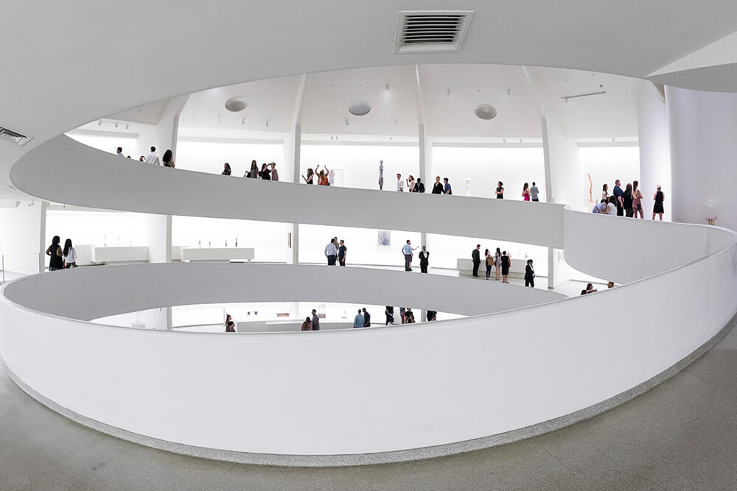
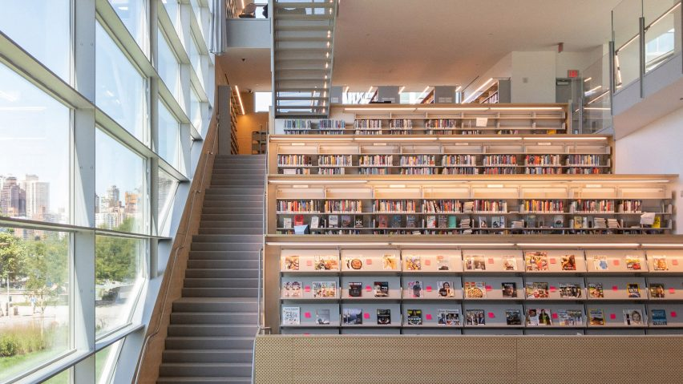
When an Architectural Gem Is Not Accessible to All - The New York Times (nytimes.com)
Notes:
Here’s an image that means something to me.
Design for wheelchair users – but work for many more groups. This solution is integration rather than segregation.
The ramp – so inclusive, bikes, wheelchairs, prams, oldest and youngest

Slide 17
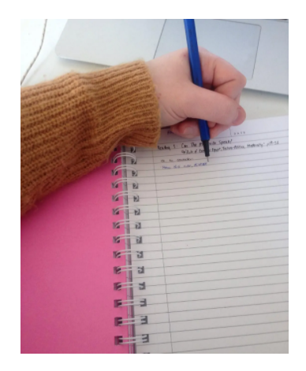
Notes:
Does this image mean anything to anyone here?

Slide 18
Please complete:
Mother/Father:
Husband/Wife:
Marital status:
Please complete:
Parents/guardians:
Spouse/partners:
Relationship status:
My new favourite form. Really. - Government Digital Service (blog.gov.uk)
Focus on Forms and Policy: Creating an Inclusive Environment for LGBT Patients
Notes:
My new favourite form. Really. - Government Digital Service (blog.gov.uk)

Slide 19
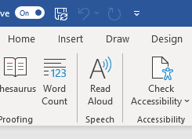

Slide 20
How design can exclude
Share something that stood out for you!

Slide 21
Inclusive design
Inclusive design
is the practice of intentionally including the needs of people who experience exclusion in many aspects of their daily lives – throughout our design process.

Slide 22
Designing with empathy
"Empathy is at the heart of design. Without the understanding of what others see, feel, and experience, design is a pointless task.“
Tim Brown — IDEO

Slide 23
Design a purse or wallet
You’ll need:
Paper and pen
Your current purse/wallet
Notes:
Task master : guide the group/ support the other to complete the task / be an observers
Designer: You job to lead the design process. You’ll be propose a design and then proposing a person-centred solution
User: you’ll be part of the design process by describing your experiences and what you need

Slide 24
Agree roles:
Task master
You will be supporting the others to complete this task.
Guide them through the instructions and keep the group to time.
Be an observer and help the group reflect on the process.
Designer
You will lead the design process.
You’ll propose an initial solution.
You’ll involve the user in the process to generate new ideas.
User
You’ll be part of the design process.
You share your experiences and needs with the designer.
You reflect on your experience of being involved.
Notes:
Task master : guide the group/ support the other to complete the task / be an observers
Designer: You job to lead the design process. You’ll be propose a design and then proposing a person-centred solution
User: you’ll be part of the design process by describing your experiences and what you need

Slide 25
3 minutes
Make a rough sketch of a wallet or purse. Highlight some features and needs your solution addresses.
5 minutes
Interview the user
Learn about how they use their wallet or purse.
Your job is to design something meaningful for this person, so dig in - find out what is important for them.
Ask the person to take it out and show you the contents.
What are some of the emotionally charged objects —pictures of children or pets? What stands out?
Invite them to tell you stories about the things they hold.
Ask why - a lot!
5 minutes
Get another piece of paper and come up with new solutions for your user – more than one if you want.
They don’t need to be wallets!
Maybe the interview will trigger something else.
Don’t worry about being sensible, just explore and respond to your user.

Slide 26
Inclusive design
Inclusive design
is the practice of intentionally including the needs of people who experience exclusion in many aspects of their daily lives – throughout our design process.

Slide 27
Discussion
Discuss the experience
What do you notice?
How was the experience the second time compared with the first?
How did it feel to connect with the user?
Notes:
More interesting, funny, or even innovative ideas?
Was it easier to generate ideas?
Do the second set of ideas feel more tailored?
Key lessons for you:
With any luck you got to experience:
the value of designing with users
interviewing skills
idea generation

Slide 28
Designing with empathy
What do you notice?
Were your ideas different the second time around? In what way?
more interesting, funny, or even innovative?
Was it easier to develop ideas?
Do the second set of ideas feel like they are more tailored to meet the needs of the person you talked to? If so…. you’ve experienced the power of empathy in action.
Notes:
Place your 2 sheets of paper side by side and email a photo.
With any luck you still got to see how designing a product with insights from user observation is a much more productive process than starting from scratch.

Slide 29
Designing inclusively…first steps
Person-centred: Involve and put people at the centre of your design process.
Understand exclusion: Listen to the experiences of people you might be unintentionally excluding.
Leverage diversity: Exclusion happens when we solve problems using our own biases. Involve people with different perspectives. Make sure to include the people that have difficulty using your current approaches.
Start small and simple: Test and refine your ideas to make sure they meet people's needs.

Slide 30
Launch package
EDI toolbox | A toolbox to help you learn about the basics of equality, diversity and inclusion in sport, and progress to learning about inclusive design. | Live now! sportscotland website “about us”
EDI bitesize | 1 hour workshops and elearning on a range of EDI fundamentals | July
Thought leaders events | A space for conversations and chance to meet inclusive designers and people with a wide range of lived experience. | July

Slide 31
Next steps…
We can learn from others.
You are joining a community of organisations
who are bringing design thinking to the problem of inequality and exclusion.

